Slide 1

RAJASTHAN POLICE HACKATHON 1.0
Pitch Deck
RJPOLICE_HACK_1210

Slide 2

Rajasthan Police Hackathon 1.0
One stop solution for Police

Slide 3
Vision and Mission
Vision
Mission
Revolutionizing law enforcement with an innovative Android app, ensuring proactive crime prevention, seamless collaboration, and community trust.
Empowering law enforcement with a cutting-edge Android app, fostering seamless communication, advanced incident management, and community collaboration for enhanced public safety

Slide 4
Problem Statement
Solution
No instant incidence reporting
No one stop solution to address police activities
Lack of proper feedback mechanism, Social Platform and Community addressal system.

Slide 5

One-Stop Solution
5
3
Web Application for User
Website, Social Media Platform, Emergency Notification System
1
Android Application for User
Android Application for Police & Admin
4
2
Web Application for Police and Admin

Slide 6
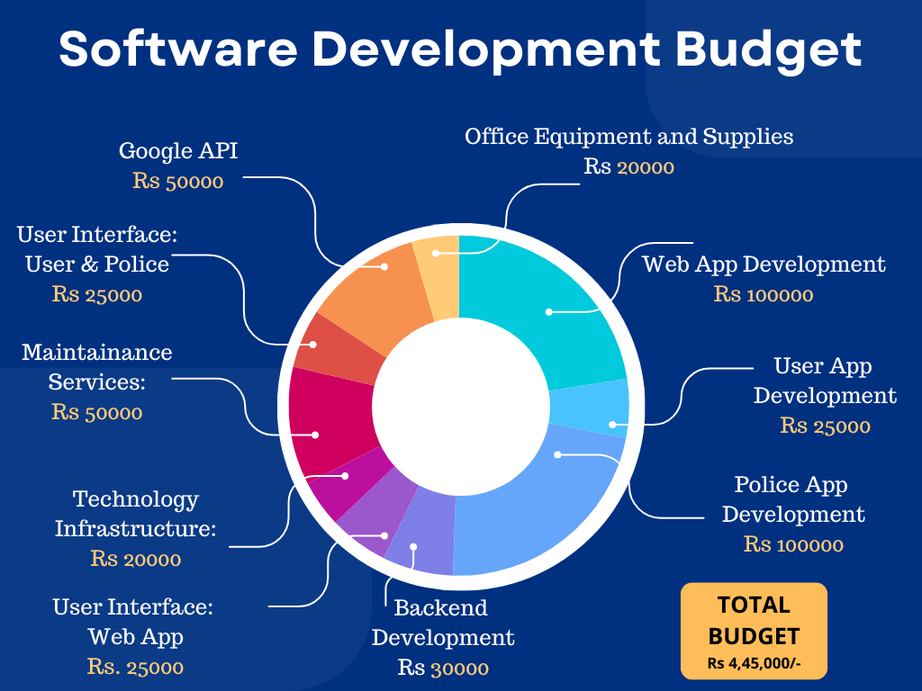

Slide 7
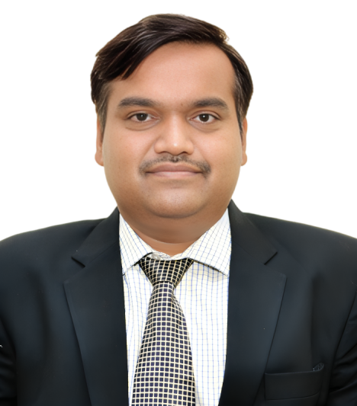
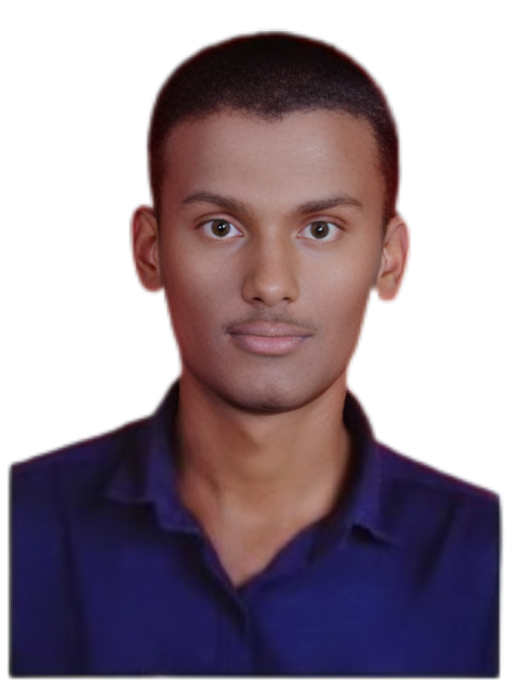
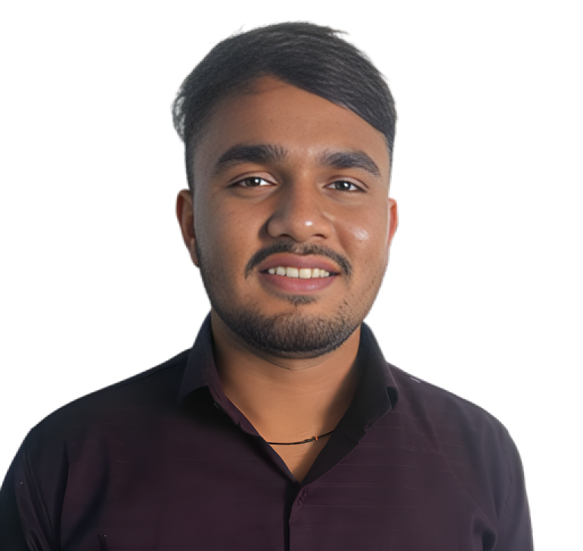

Team Members
Mr. Jeve Kishor S.
Mr. Amol Kumbhar
Mr. Omkar Kshirsagar
Mr. Ganesh Sagave
Founder & Director,
LTR SOFT
Co-Founder & Director,
LTR SOFT)
Intern
Intern

Slide 8
Thank You!!!

